Slide 1
Comprehensive Community Services (CCS)
Wisconsin Human Services Financial Management Association (WHSFMA)
May 7, 2015

Slide 2

Agenda
CCS Overview and Policy Update, Wisconsin Department of Health Services (DHS)
  CCS Program Overview
  CCS County Participation
  Roles and Responsibilities
  2014 Regionalization
  CCS Financial Process
  2014 Billing Updates
CCS Cost Settlement, Public Consulting Group (PCG)
  Annual Cost Settlement Cycle
  Calendar Year (CY) 2014 CCS Report Structure
  Regional Reporting
  Management Reports
  Next Steps
  2014 CCS Timeline
Contacts and Questions

Slide 3

CCS Overview and Policy Update
Steven Kulig, Wisconsin Department of Health Services

Slide 4
What Is CCS?
CCS stands for Comprehensive Community Services.
Mental health and substance abuse program.
Provides programming to people of all ages—youth to elderly—living with a mental illness and/or substance use disorder.
CCS is for individuals who need ongoing services beyond occasional outpatient care, but less than the intensive care provided in a hospital setting.
The individual works with a dedicated team of service providers to develop a treatment and recovery plan to meet the individual's unique needs and goals.
A 2013 study of the consumer experience in CCS found that this targeted, community-based approach is effective in promoting better overall health and life satisfaction.
CCS reduces an individual's reliance on costly high-end services, such as emergency room visits.

Slide 5
Participating CCS Programs by Year
*Estimated CCS programs

Slide 6
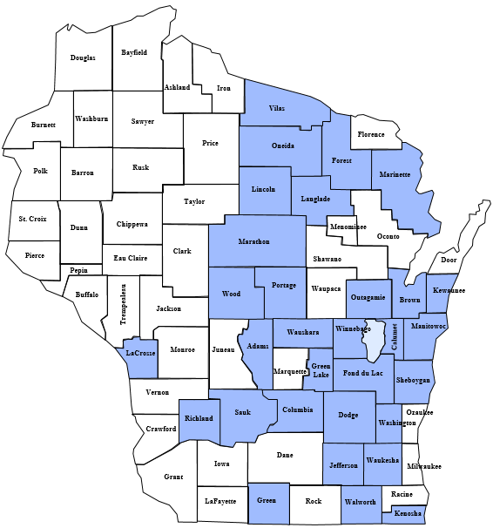
Participating CCS Programs
Prior to regionalization effective July 1, 2014
CCS counties
(31 counties total, including counties part of 51.42 agencies)
Non-CCS counties

Slide 7
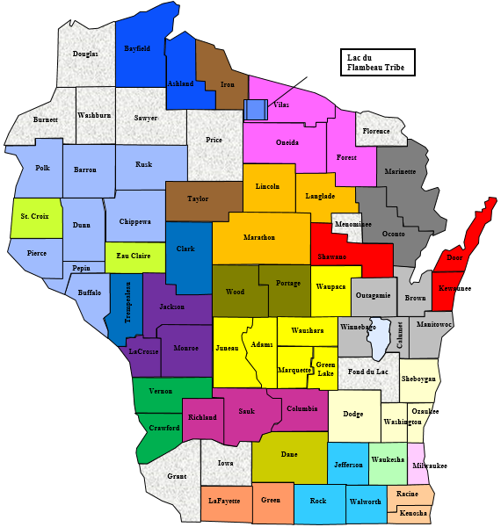
Participating CCS Programs
Regional participation as of April 1, 2015
63 counties and one tribe currently in CCS (includes Fond du Lac as non-regional participant)
Color coding reflects 24 regional CCS entities:
  21 county-based programs
  2 51.42 programs
  1 tribal-based program

Slide 8
Total Interim CCS Claim Payments
By annual dates of service (in millions of dollars)

Slide 9
Calendar Year (CY) 2014 Interim
Claims Activity
Interim Claims Activity for CY 2014 Dates of Service
Type | State Share | Federal Share | All Funds | Percentage of Total
Non-Regional | - | 7,884,898.28 | 7,884,898.28 | 63%
Regional | 1,910,788.06 | 2,722,283.84 | 4,633,071.90 | 37%
Total | 1,910,788.06 | 10,607,182.12 | 12,517,970.18 | 100%

Slide 10
CY 2015 to Date Interim Claims Activity
Current Interim Claims Activity (January 2015–March 2015)
Type | State Share | Federal Share | All Funds | Percentage of Total
Non-Regional | - | 39,315.52 | 39,315.52 | 4%
Regional | 349,235.48 | 489,430.71 | 838,666.19 | 96%
Total | 349,235.48 | 528,746.23 | 877,981.71 | 100%

Slide 11
Regional Claims by Quarter
Percentage Breakdown of Regional and Non-Regional Claims (July 2014–March 2015)
Type | Jul–Sep | Oct–Dec | Jan–Mar
Non-Regional Claims | 42% | 11% | 4%
Regional Claims | 58% | 89% | 96%
All Claims | 100% | 100% | 100%

Slide 12
CCS Roles and Responsibilities
FEDERAL MEDICAID OVERSIGHT
Centers for Medicare and Medicaid Services
Sets federal requirements
STATE OVERSIGHT
Department of Health Services
Determines requirements for Wisconsin
OPERATIONAL & PROJECT OVERSIGHT
Public Consulting Group
Assists counties with program requirements, completes desk review
DAY-TO-DAY OPERATIONS AND OVERSIGHT
Counties and Agencies
Manages all program requirements, maintains compliance, completes cost report

Slide 13

CCS Regionalization
CCS regions must complete three steps:
  Division of Mental Health and Substance Abuse Services (DMHSAS) approval
  Division of Quality Assurance (DQA) certification
  Medicaid provider enrollment
Regional formation
  Initial formation of a region may occur at the beginning of a month from July 1, 2014, to December 31, 2015.
  One annual update to regional structure is allowed (first of the month).
  Effective January 1, 2016, additions and removals must occur on January 1.
Regionalization incentive
  Non-regional CCS providers will continue to receive only the federal share of reimbursement.
  Regional CCS providers will realize enhanced CCS payments through interim claiming and a cost-based reimbursement method.

Slide 14
CCS Regional Models
Multi-County Model
Multiple counties/tribes partner together to operate a regional CCS program across their counties/tribes; a lead county or tribe is identified.
Shared Services Model
Multiple counties/tribes partner together to operate a regional CCS program across their counties/tribes; no lead county.
County 2
Lead County 1
County 1
County 3
County 4
County 2
County 4
County 3
51.42 Model
Multiple counties that have partnered together to form a separate 51.42 legal entity operate a regional CCS program through the 51.42 entity.
Population-Based Model
A single county with a population exceeding 350,000 residents, or a single tribe, regardless of population size, operates a regional CCS program.
51.42, County or Tribe 1

Slide 15
Update to CCS Billing
Legacy CCS billing (eliminated after June 30, 2014)
  Procedure code H2018: psychosocial rehabilitation services, per diem
CCS billing updates (effective July 1, 2014)
  Procedure code H2017, psychosocial rehabilitation services, per 15 minutes
  Modifiers indicate professional type and identify services provided in a group setting
CCS billing note: billing vs. rendering provider IDs
A billing provider is the billing entity (county or tribe) that submits the interim claim.
A rendering provider is the entity that rendered the service.
Rendering provider ID may differ from billing provider ID for multi-county region.
CCS claims should reflect the rendering provider ID.

Slide 16

CCS Financial Process
Legacy method (through June 30, 2014)
  Annual rate setting
  Interim billing and CCS claims payments
  Year-end cost reporting and financial reconciliation
Updated method (effective July 1, 2014)
  Statewide rates
  Interim billing and CCS claim payments
  Updated annual cost reporting and reconciliation method
Note: CY 2014 reporting incorporates both legacy and updated reporting methodologies.

Slide 17
CCS Policy Next Steps
Moving toward cost report integration between CCS and other county-based health services programs for CY 2015 reporting
  Integration would result in a single annual cost report for Wisconsin Medicaid Cost Reporting (WIMCR) and CCS in CY 2015.
  Cost settlement will continue to be calculated independently for each program.
Pending federal approval
  Policy changes impacting Medicaid programs require approval by the Centers for Medicare and Medicaid Services (CMS).
  All anticipated updates are subject to change pending federal approval.
Broader vision to include additional mental health programs
  CCS is the first program to integrate with WIMCR reporting methodology.
  Additional mental health programs may be included at a later date.

Slide 18

CCS CY 2014 Cost Reporting
Megan Morris, Public Consulting Group

Slide 19
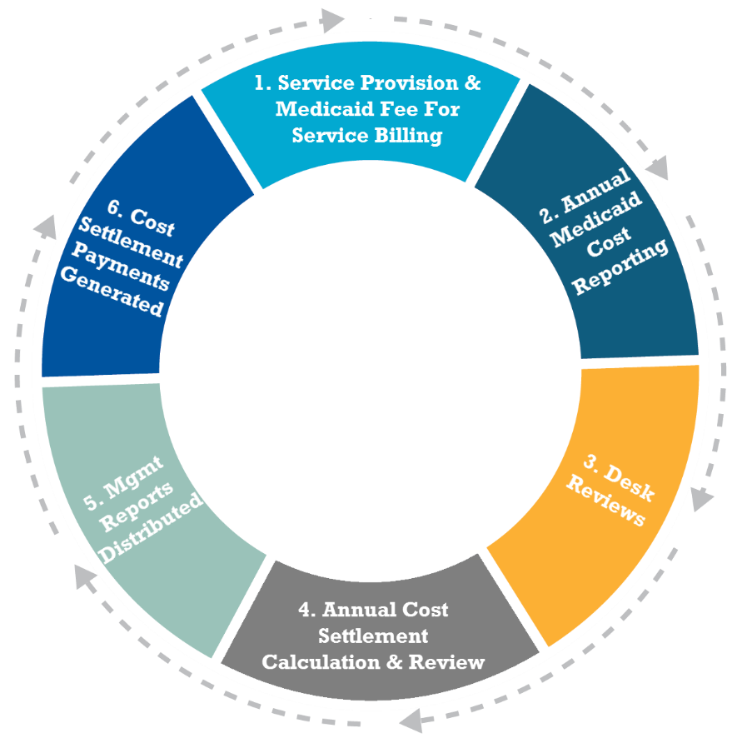
CCS Cost Settlement Cycle
www.pcghealth.com | Wisconsin Human Services Financial Management Association (WHSFMA 2015)

Slide 20

CY 2014 Cost Reporting Process
Legacy CCS reporting
  Applicable for dates of service from January 1, 2014, to June 30, 2014
  Consistent with past CCS reporting
Updated CCS reporting
  Applicable for dates of service from July 1, 2014, to December 31, 2014
  Based on CY 2013 WIMCR reporting methodology

Slide 21
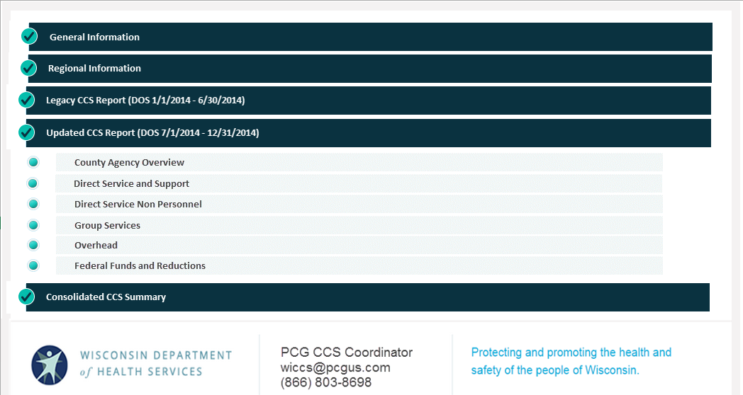
CY 2014 Cost Reporting Process (Continued)
Excel-based reporting tool (submitted by email to wiccs@pcgus.com)

Slide 22

Regional Reporting
Population-based regions and 51.42 boards
  Single consolidated cost report
Shared services and multi-county regions
  Individual report for each county
  Intergovernmental revenue offsets for regional shared clinicians and other expenses
New “Regional Information” section
  Name and ID of region
  List of all counties in region
  Date of regional formation
  Subsequent regional adjustments

Slide 23
Intergovernmental Agreements
Intergovernmental agreements
  An intergovernmental agreement occurs when an employee of one county or tribal reporting entity provides services on behalf of a second reporting entity and the second reporting entity reimburses the first reporting entity for services provided. The graphic on the next slide shows an example intergovernmental agreement.
Regional shared
  The term “regional shared” is used to identify an individual or a category of overhead used to support multiple counties.
Revenue offset
  A revenue offset is the dollar amount paid from one county to another for services provided by a regional shared clinician or overhead provider.

Slide 24
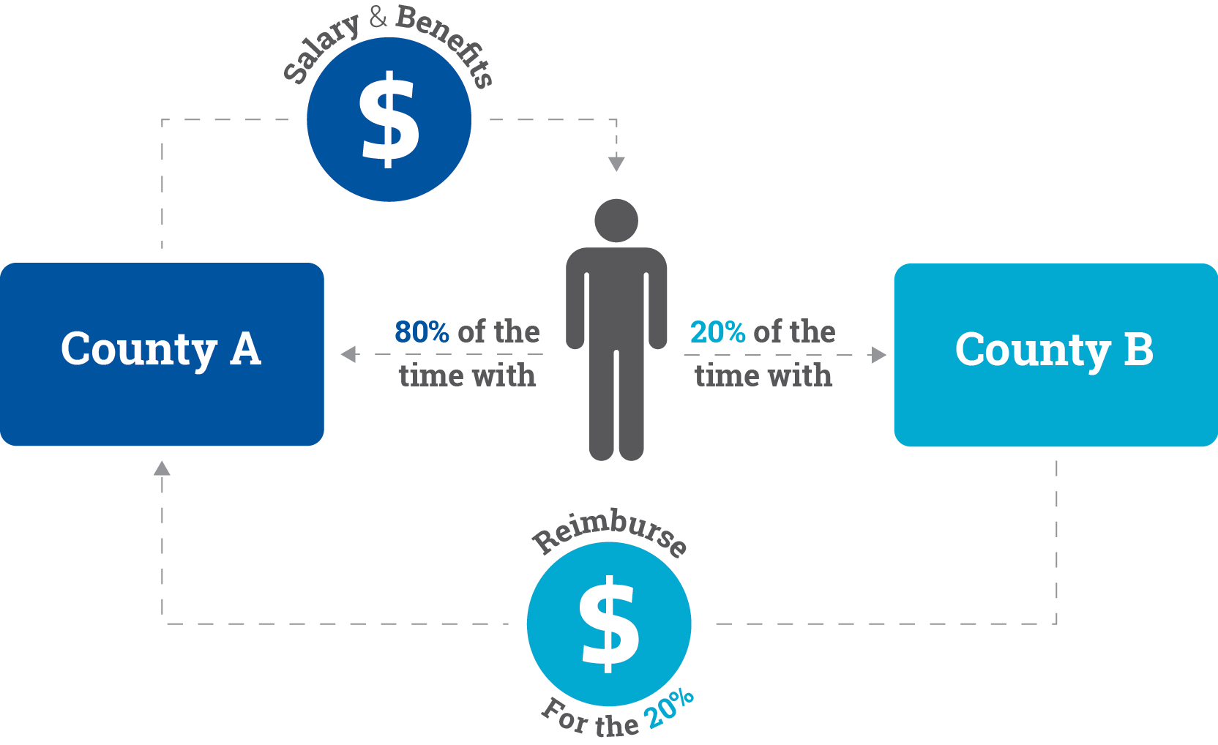
Intergovernmental Agreements (Continued)

Slide 25
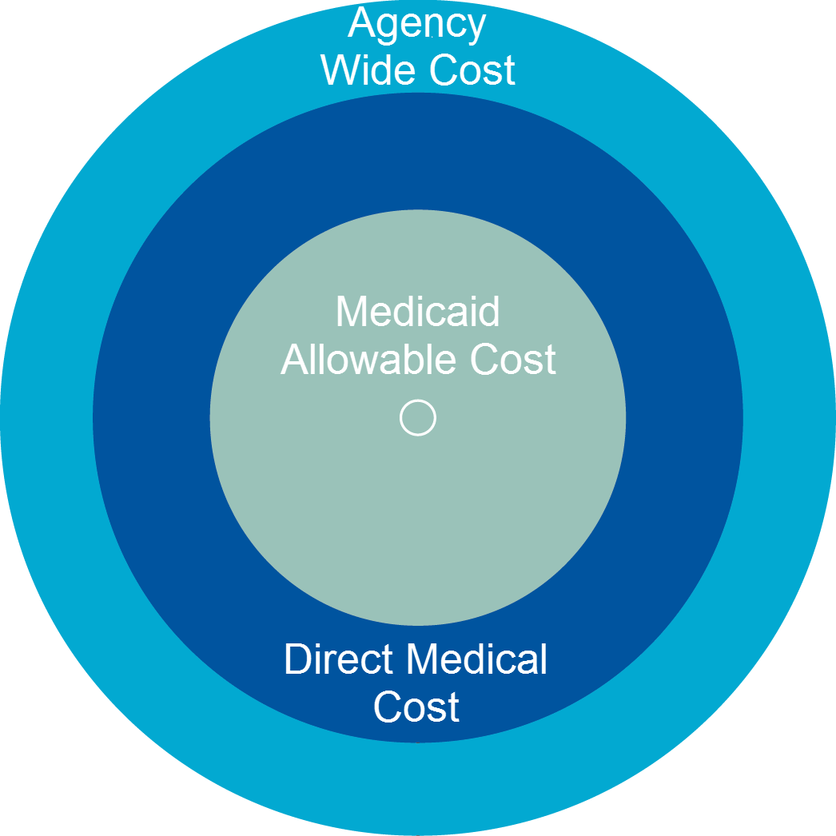
Management Reports
Provider Summary Report (PSR)
  Calculate county cost (cost per unit from cost report).
  Multiply by total Medicaid claims.
  Subtract fee-for-service (FFS) claims.
PSR notes
  PSR structure and calculation vary based on date of regionalization.
  In CY 2014, step 1 value will vary from January–June (legacy method) and July–December (updated method).
Regional reports
  Regional payment summary
  Intergovernmental agreements report

Slide 26
CY 2014 CCS Reporting Timeline
Date | Event
May 18, 2015 | CY 2014 CCS tool and guide available
May 18–22, 2015 | Regional CCS cost reporting trainings
May 25–29, 2015 | Additional webinar CCS cost reporting trainings
June 1–August 14, 2015 | Submission of completed CY 2014 CCS reports via email
August 17–September 18, 2015 | Desk reviews for CY 2014 CCS reports
December 2015 | Distribution of CY 2014 management reports
December 2015 | Processing of final CY 2014 CCS payments

Slide 27
What’s Next for CCS Reporting?*
CCS reporting: CY 2015
  Only the updated cost reporting methodology will be used (aligns with WIMCR CY 2013).
  Reporting will take place in web-based tool.
  Single consolidated CCS/WIMCR report to alleviate reporting burden on providers and ensure no cost is duplicated.
  Adjustments to regional formations will be allowable on the first of any month (once per calendar year).
CCS reporting: CY 2016 and after
  Only the updated cost reporting methodology will be used (aligns with WIMCR CY 2013).
  Reporting will take place in web-based tool.
  Single consolidated CCS/WIMCR report to alleviate reporting burden on providers and ensure no cost is duplicated.
  Adjustments to regional formations will be allowable only on January 1.
*Next steps are pending federal CMS approval.

Slide 28
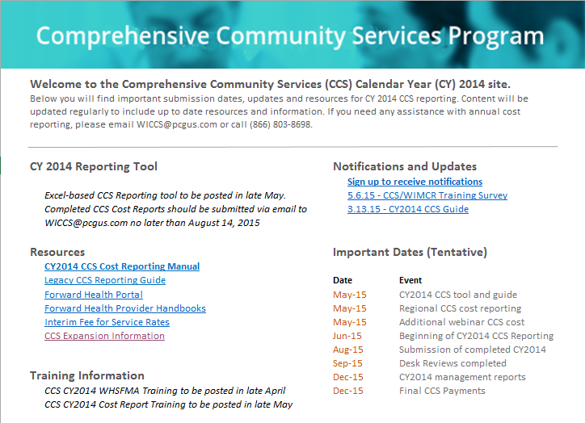
Resources
Resource | Link
CCS CY 2014 reporting: CCS reporting tool Cost reporting instruction manual Notifications and updates Resources Important dates Training information Contact information | wimcr.com/ccs
CCS expansion | dhs.wisconsin.gov/ccs/expansion
CCS notification sign-up | surveymonkey.com/r/67YZRLJ
ForwardHealth portal | forwardhealth.wi.gov

Slide 29

Contacts and Questions
Steven Kulig
Budget and Policy Analyst
Wisconsin Department of Health Services
Megan Morris
CCS Coordinator
Public Consulting Group
CCS Cost Reporting Questions
wiccs@pcgus.com
(866) 803-8698
CCS Financial Questions
DHSDMHSASCCS@dhs.wisconsin.gov

Slide 30
ICD-10 Implementation
CMS has mandated that all HIPAA-covered entities implement the ICD-10 code sets by October 1, 2015.
DHS is preparing our systems and evaluating impacts to policy and communications in anticipation of the October 1 implementation.
More information on ICD-10 transition can be found on the ICD-10 Code Set Transition Home Page on the ForwardHealth Portal, https://www.forwardhealth.wi.gov/

Slide 31
ICD-10 Implementation
Important Dates and Information
  DHS Brown Bag Trainings:
    Tuesday, May 19th, 2015.
    Tuesday, July 21st, 2015.
    Tuesday, August 18th, 2015.
  Provider Updates with additional information are forthcoming for early June.
  Voluntary testing through the Department’s online testing environment will be available to providers starting in July.
Any questions on ICD-10 implementation can be directed to VEDSICD10Support@Wisconsin.gov.

